Slide 1

1
Virtual Kinetics Lab: Reaction Software
Online Workshop
Thermochemical and Kinetic Parameters
Reaction Mechanism, pMuTT, pGrAdd

Slide 2
Agenda
Intro
Motivation
Link
Reaction Mechanism
Site vs State Model
Site model: Manual
Site model: Auto reaction mechanism generation
State model: Manual

Slide 3

Agenda
Thermochemistry & Kinetics
Statistical thermodynamics overview
DFT to Macro Thermochemical Properties
Transition state theory (TST)
Reaction barriers
Pre-exponential factors
Python Multiscale Thermodynamic Toolbox (pMuTT)
Overview
Code demonstration
Misc
Re-referencing to standard state
Lateral Interactions
Empirical expressions

Slide 4

Agenda
Semi-Empirical Methods
Group additivity
Bronsted-Evans-Polyani (BEP) Relationships
Linear Scaling Relationships (LSR)
Python Group Additivity (pGrAdd)
Code demonstration
Python Code Examples
DFT→pMuTT→openMKM
Group addivity
Interesting applications (Error propagation & Dynamic catalysis)

Slide 5
Introduction
Reaction mechanism
Thermochemistry & Kinetics
MKM Modeling Tool
Post-modeling analysis
Elementary reactions or States
Species
Enthalpy, entropy, heat capacity
Reaction barriers
Pre-exponential factors
MKM input files
Solve system of equations
Apply applicable constraints
Provide output
Time evolution
Reaction path analysis
Rate-limiting step
MARI/MASI
Reaction order
Apparent reaction barrier
Manual or RING
openMKM
pMuTT, pGrAdd, BEP, LSR
ReNView

Slide 6
Reaction Mechanism: Site vs State Model
Site model
Active sites/Site density
Exclusion principle
Lateral interactions
Exhaustive elementary reactions
Mean-field
Ideal for typical heterogeneous catalysis
State model
Active sites/Site density
States vs sites
No interactions
States defined manually
Ideal for single atom and Zeolites

Slide 7
Reaction Mechanism: Site Model
Simple reaction mechanism
1-2 Site types (Terrace vs step, Pt(111) & Pt(211))
Small molecules (CH4, NH3)
Manually generate all elementary reactions
Large reaction mechanism
>2 Site types
Large molecules
Automatic reaction mechanism generator (RING)

Slide 8
Reaction Mechanism: Simple Site Model
Ammonia: 2 Ru active sites (Terrace & Step)
Summary
19 Reactions
3 Gas species
10 Surface species

Slide 9
Reaction Mechanism: Large Site Model
Manual construction generally impractical
Automated network generators
Generate all possible reactions and species of the network
Use reaction rules as basis – “rule-based”
Chemistry | System | Reactions (species)
Heterogeneous catalysis | Propane aromatization | 19907 (5909)
Gas phase combustion | Hexadecane combustion¹ | 8130 (2116)
Metabolism | E.coli genome² | 2077 (1039)
Metal chemistry | Glycerol decomposition³ | 3313 (537)
¹ Combustion and Flame 2009, 156 (1), 181; ² Mol Syst Biol. 2007, 3, 121; ³Green Chem., 2014,16, 813

Slide 10




Reaction network generator can be used to construct the network
Initial reactants
RING
Reaction rules
List of species
List of reactions
Reaction network
Kinetic modeling
Semi-empirical analysis
Network analysis
¹ Ind.Eng.Chem.Res. 1994, 33, 790; ² AIChE Journal 2006, 52, 718; ³ Chemical Engineering Science 1992, 47, 2713; ⁴ J.Chem.Inf.Model. 2003, 43, 36;
⁵ Comp. Chem.Eng. 2008, 32, 2455; 6 Combustion & Flame, 2001, 126, 1780

Slide 11
Rule Input Network Generator (RING) for network generation
Reactants
Reaction Rules
Reaction Network Generator
Reaction list
Species list
Inputs:
Cheminformatics Graph theory Graph transformation
Initial reactants
System-specific rules
Reaction Language Compiler
Reaction Network
Post-processing instructions
Post-processing module
Domain specific English-like language using SILVER*
Depth-first search Molecular hashing Subgraph extraction

Slide 12
RING language: rule inputs
User-specification
input reactant “C=CC”
input reactant “[{Zeo}H] ”
input reactant “N#N”
rule OlefinAdsorption{
gasPhase reactant r1{
C labeled c1
C labeled c2 double bond to c1}
reactant r2{
Zeo labeled z1 {! connected to >=1 C
with any bond}
H labeled h1 single bond to z1}
constraints{! r1 is cyclic}
form bond (c1,z1)
decrease bond order (c1,c2)
form bond (c2,h1)
break bond (z1,h1) }
REACTANTS
c₂
Transformations
c₁
h₁
REACTION CENTER
z₁
Reaction
Center
Final
configuration
CONSTRAINTS
TRANSFORMATIONS

Slide 13
RING Ruleset: Typical hydrocarbon
input reactant "CCC"
input reactant "{Pt}"
define composite atom Pt
global constraints on Molecule{
fragment f1{
C labeled c1
C labeled c2 double bond to c1
Pt labeled p1 single bond to c1
}
fragment f2{
C labeled c1
C labeled c2 triple bond to c1
Pt labeled p1 single bond to c1
}
! Molecule contains >=1 of f1
! Molecule contains >= 1 of f2
}
rule CCScission{
reactant r1{
C labeled c1
C labeled c2 single bond to c1}
reactant r2{
Pt labeled m1{!connected to >0 $ with any bond}}
reactant r3 duplicates r2 (m1=>m2)
break single bond(c1, c2)
form single bond(c1, m1)
form single bond(c2, m2)}
rule CHScission{
reactant r1{
C labeled c1
H labeled h1 single bond to c1}
reactant r2{
Pt labeled m1{!connected to >0 $ with any bond}}
reactant r3 duplicates r2 (m1=>m2)
break single bond(c1, h1)
form single bond(c1, m1)
form single bond(h1, m2)
}
rule OHScission{
reactant r1{
O labeled o1
H labeled h1 single bond to o1}
reactant r2{
Pt labeled m1{!connected to >0 $ with any bond}}
reactant r3 duplicates r2 (m1=>m2)
break single bond(o1, h1)
form single bond(o1, m1)
form single bond(h1, m2)
}

Slide 14
RING Ruleset: Output for CCC
Reactions (144) C(C)C.[{Pt}].[{Pt}]>>C([{Pt}])C.[{Pt}]C
C(C)C.[{Pt}].[{Pt}]>>C([{Pt}])(C)C.[{Pt}H]
C(C)C.[{Pt}].[{Pt}]>>C(C[{Pt}])C.[{Pt}H]
C([{Pt}])C.[{Pt}].[{Pt}]>>[{Pt}]C[{Pt}].[{Pt}]C
C([{Pt}])C.[{Pt}].[{Pt}]>>C([{Pt}])([{Pt}])C.[{Pt}H]
C([{Pt}])C.[{Pt}].[{Pt}]>>C(C[{Pt}])[{Pt}].[{Pt}H]
[{Pt}]C.[{Pt}].[{Pt}]>>[{Pt}]C[{Pt}].[{Pt}H]
C([{Pt}])(C)C.[{Pt}].[{Pt}]>>C([{Pt}])([{Pt}])C.[{Pt}]C
C([{Pt}])(C)C.[{Pt}].[{Pt}]>>C([{Pt}])([{Pt}])(C)C.[{Pt}H]
C([{Pt}])(C)C.[{Pt}].[{Pt}]>>C(C[{Pt}])([{Pt}])C.[{Pt}H]
C(C[{Pt}])C.[{Pt}].[{Pt}]>>C([{Pt}])C.[{Pt}]C[{Pt}]
C(C[{Pt}])C.[{Pt}].[{Pt}]>>C(C[{Pt}])[{Pt}].[{Pt}]C
C(C[{Pt}])C.[{Pt}].[{Pt}]>>C(C[{Pt}])([{Pt}])C.[{Pt}H]
Etc.
Species (55)
C(C)C 3 0
[{Pt}] 1 0
C([{Pt}])C 3 1
[{Pt}]C 2 1
C([{Pt}])(C)C 4 1
[{Pt}H] 1 1
C(C[{Pt}])C 4 1
[{Pt}]C[{Pt}] 3 2
C([{Pt}])([{Pt}])C 4 2
C(C[{Pt}])[{Pt}] 4 2
C([{Pt}])([{Pt}])(C)C 5 2
C(C[{Pt}])([{Pt}])C 5 2
C(CC)([{Pt}])[{Pt}] 5 2
C(CC[{Pt}])[{Pt}] 5 2
C([{Pt}])([{Pt}])[{Pt}] 4 3
C([{Pt}])([{Pt}])([{Pt}])C 5 3
C(C[{Pt}])([{Pt}])[{Pt}] 5 3
C=C 2 3
Etc.

Slide 15
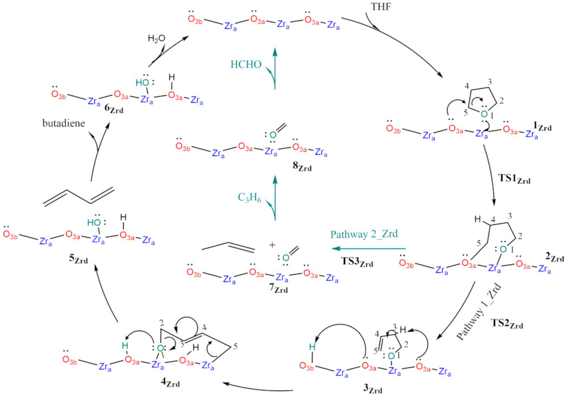
Reaction Mechanism: State Model
Reactions proceed from state to state
“Species” = States
Each state contains all the reactants or products
Limited to the proposed reaction paths…Might not be comprehensive
(1) Batchu, S. et.al.. Chem. 2023, 5 (1), 422–437.

Slide 16
Statistical Thermodynamics
The collective body of statistical mechanics is based on two main postulates:
Equal a priori probability postulate
All microstates of the system of volume V that have the same energy and the same number of particles are equally probable
Ergodic hypothesis
The (long) time average of any mechanical property in a macroscopic system is equal to the average value of that property over all the microscopic states of the system, each weighted with its probability of occurrence, provided that the microscopic states replicate the thermodynamic state and environment of the actual system

Slide 17


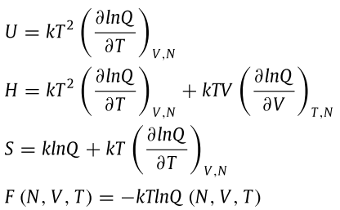
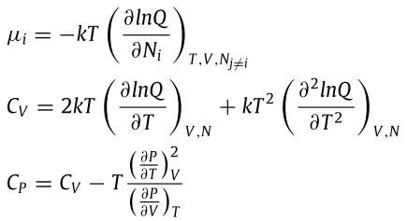
Statistical Thermodynamics: Partition functions and thermodynamic properties
For canonical ensemble

Slide 18
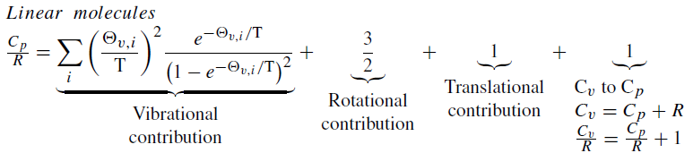
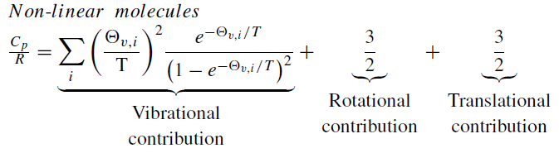
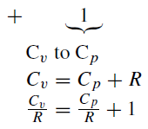
Statistical Thermodynamics: Macro thermodynamic properties-Heat Capacity

Slide 19
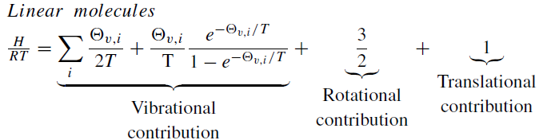
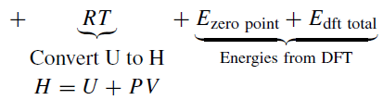
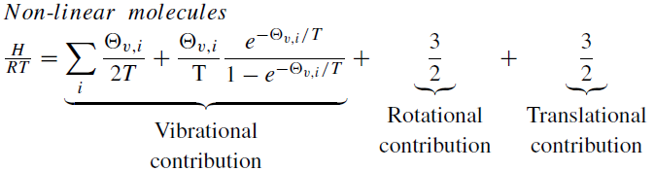
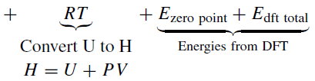
Statistical Thermodynamics: Macro thermodynamic properties-Enthalpy

Slide 20
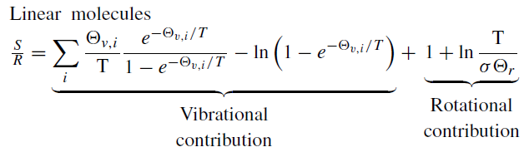
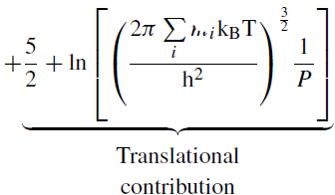
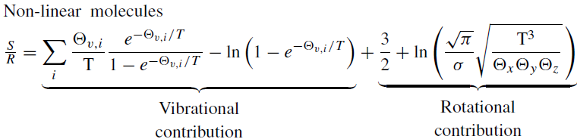
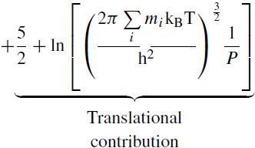

Statistical Thermodynamics: Macro thermodynamic properties-Entropy

Slide 21
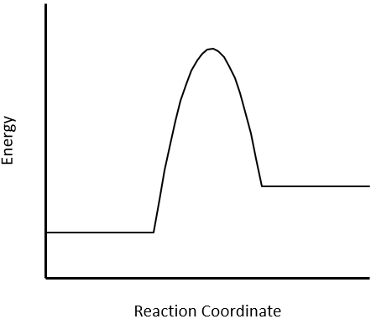
Transition State Theory: Reaction barrier and Pre-exponential factor
Reaction Barrier
Transition State
A --- B
E‡
E_{a}
E^{IS}
AB
E^{FS}
Pre-exponential factor
A + B
Final State
E_{Rxn}
Initial State

Slide 22
Miscellaneous: Re-referencing
DFT derived thermochemistry is not at standard conditions
Misstates energy
Need to atomistically adjust DFT derived thermochemistry to account for:
Standard temperature
Atomistic formation energies
Error in DFT
Methods:
Use know adsorption energies regressed to constituent atoms to shift DFT data
Use DFT computed vs experimental thermochemistry for reference gases regressed to constituent atoms to shift DFT data
A
E
G
Experimental (NIST): STP
C*
E*
A*
B*
DFT: STP
D*
F*
G*
C*
E*
A*
B*
DFT: Not STP
D*
F*
G*

Slide 23
Miscellaneous: Re-referencing
Name | NIST Enthalpy (kcal/mol)
CH₄ | -17.89
CH₃OH | -49.0
CH₃CH₃ | -20.0
CH₂CH₂ | 12.54
CH₃CH₂OH | -56.0
H₂O | -57.798
CO₂ | -94.051
H₂ | 0.0
Pseudo-inverse
C
H
O
Apparent contribution to error per atom

Slide 24
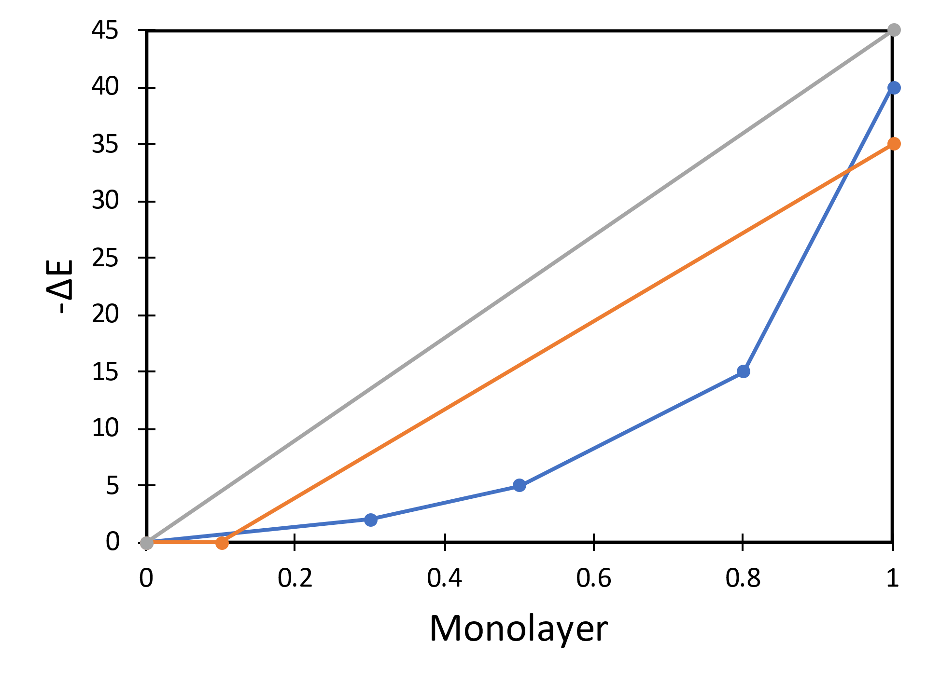
Miscellaneous: Lateral Interactions
Multiple species adsorbed on the surface of a heterogeneous catalyst can impact their energy
Some modeling tools (KMC) that track the position of all surface species provide multiple energies for all species based on 1st, 2nd, n^{th} nearest neighbors.
Mean field model do not track exact adsorbate positions must rely on average surface coverages.
These corrections are often critical to model accuracy by not overstating adsorbate coverages.
These are expressed as the impact pairs of adsorbates have on each other using one or more linear relationships
I₅
S₄
I₄
I₃
S₃
I₂
S₂
I₁
S₁

Slide 25
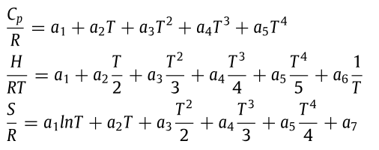
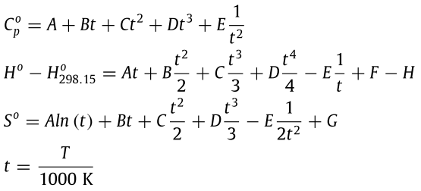
Miscellaneous: Empirical Relationships
Simpler representation of thermodynamic property as function of temperature
Fitted using statistical thermodynamic or experimental data
Required by many material modeling programs
NASA Polynomials (7-coefficient)
Shomate Polynomials (NIST)
NASA Polynomials (9-coefficient)

